Slide 1


Dental Clinic Services System
1
10/29/2014
Kanokwan Maneerat 542115002
Worapun Wongkium 542115055

Slide 2

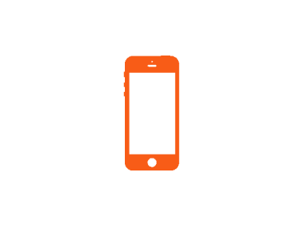


Agenda
2
Project Overview
Limitation
Software Methodology
Schedule
Features
System architecture & Design
Use Case Diagram & Description
Software Requirement Specification
Class Diagram
Sequence Diagram
Testing
Demo

Slide 3

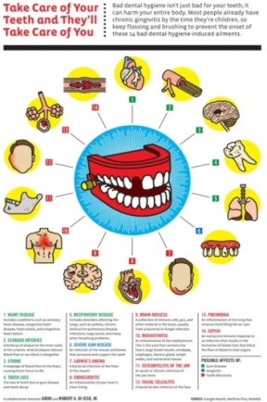
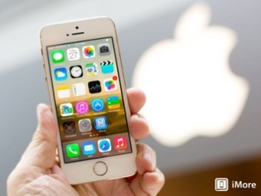



Project Overview
3
Dental clinic service system is created for reducing officers’ work and providing convenience to patients. This project will provide the dental clinic schedule for patients, officers, and dentists.

Slide 4
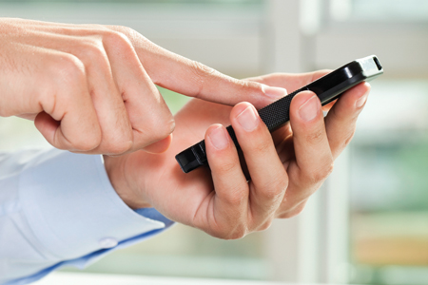

Project Overview
4
User
Visitor
Dental treatment cost estimation
Dental clinic information and promotion
Patient
QR code identification
Dental clinic follow up
Dental treatment cost estimation
Dental clinic information and promotion

Slide 5
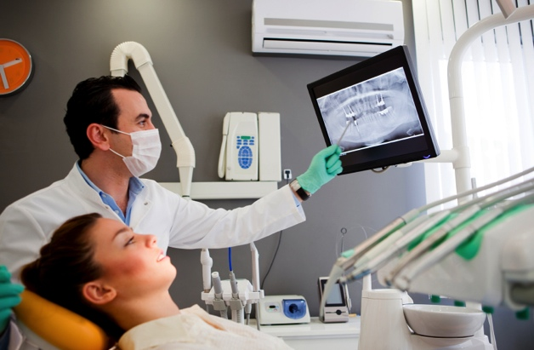

Project Overview
5
User
Dentist
Follow up by asking question to the patient
View the answer from patient

Slide 6
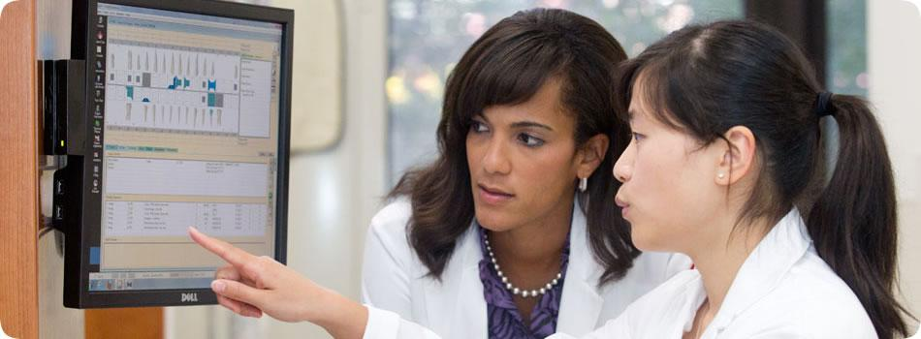

Project Overview
6
User
Officer
Add patient to a queue
Reset a queue
Manage dental clinic information and promotion
Manage dental clinic treatment

Slide 7
Project Overview
7
Dental clinic service system consists of a mobile application on iOS and a web application
Patient can login to view the personal information including QR code
Patient and Dentist can do a follow up
Patient and Visitor can estimate the cost of dental treatment
Patient and Visitor can view dental clinic information and promotion
Officer can add patient to a queue
Officer can add/edit/delete dental clinic information ,promotion and dental treatment
Patient can login to view the personal information including QR code
Patient can view dental clinic information and promotion
Patient can estimate the cost of dental clinic treatment
Patient can follow up with dentist

Slide 8




Limitation
8
Wifi and 3G
Should connect with the internet first
IOS7
Should use the ios7 or newer version
** Cannot insert a patient to the already taken queue

Slide 9
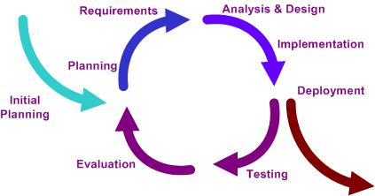
Software methodology
9
Iteration
develop a system through repeated cycles (iterative) and in smaller portions at a time (incremental)

Slide 10
Schedule
10
Progress 1 | Feature 1: Schedule management Feature 2: Appointment management Feature 3: User registration and authentication | 07/31/14
Progress 2 | Feature 4: Patient identification using QR code Feature 5: Dental care consulting and following up Feature 6: A dental clinic information and promotion Feature 7: Cost estimation of dental treatments | 10/22/14
Final Progress | Feature 4: Patient identification using QR code Overall documentation | To be completed by 12/11/14

Slide 11
Features
11
Feature 1: Schedule management
Feature 2: Appointment management
Feature 3: User registration and authentication
Feature 4: Patient identification using QR code
Feature 5: Dental care consulting and following up
Feature 6: A dental clinic information and promotion
Feature 7: Cost estimation of dental treatments

Slide 12
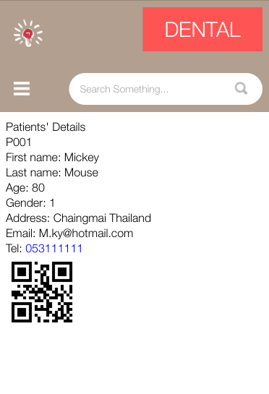
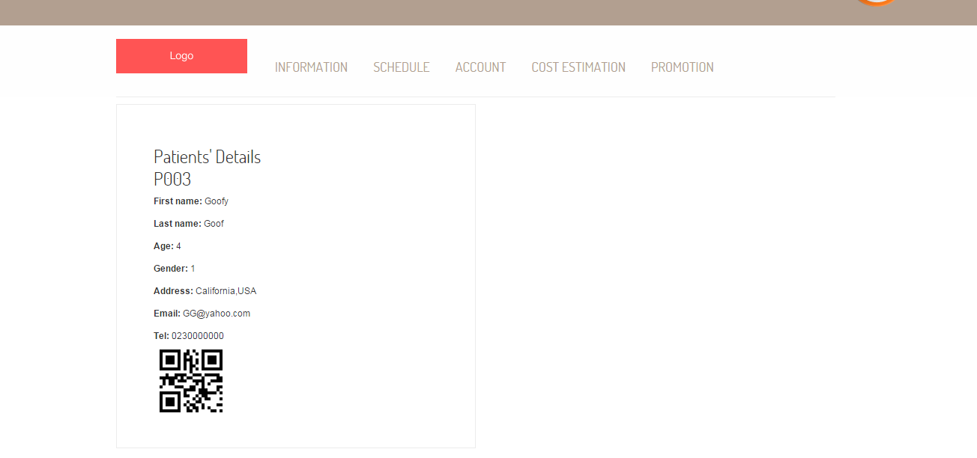
Features
12
Feature 4: Patient identification using QR code
Mobile application
Web application

Slide 13
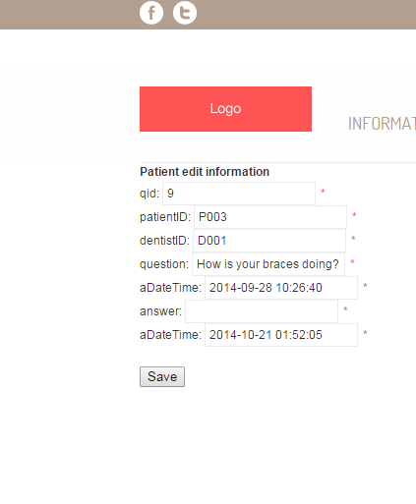
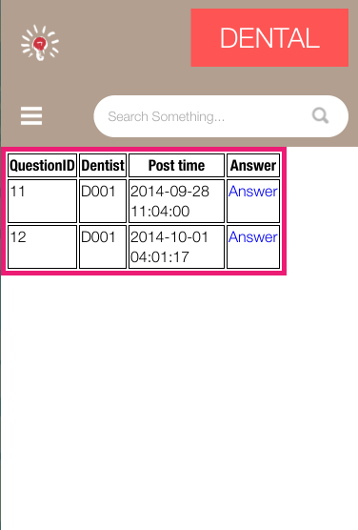
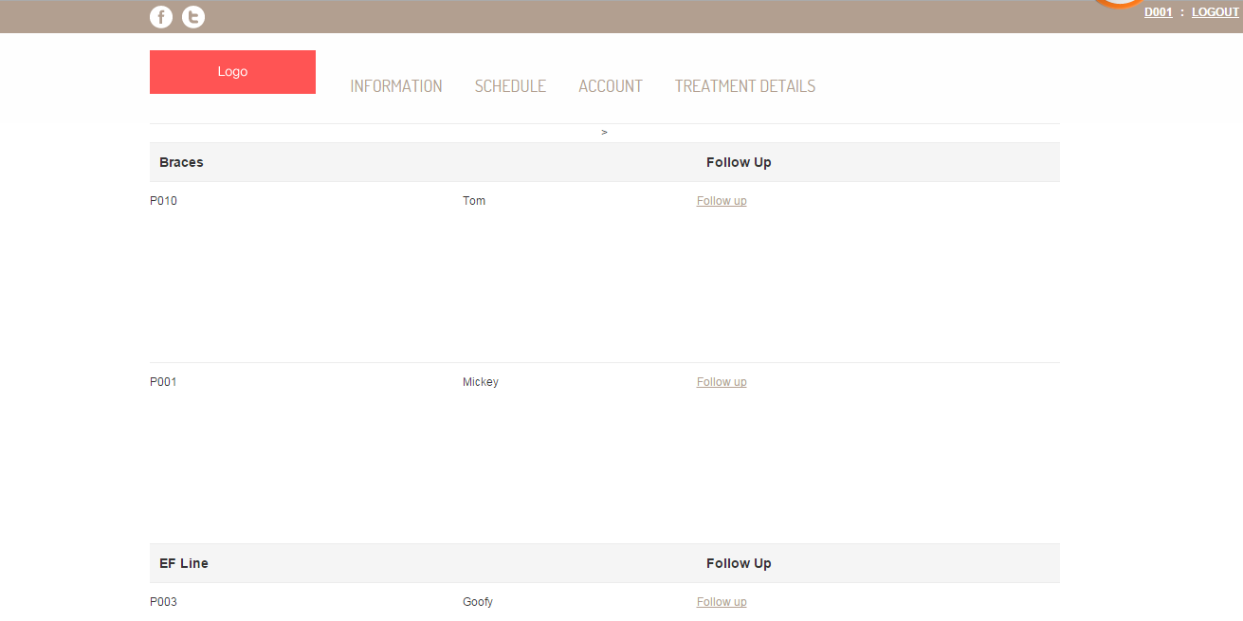
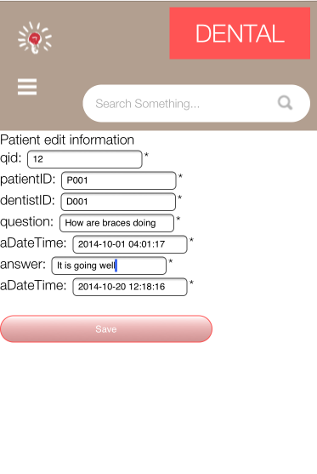
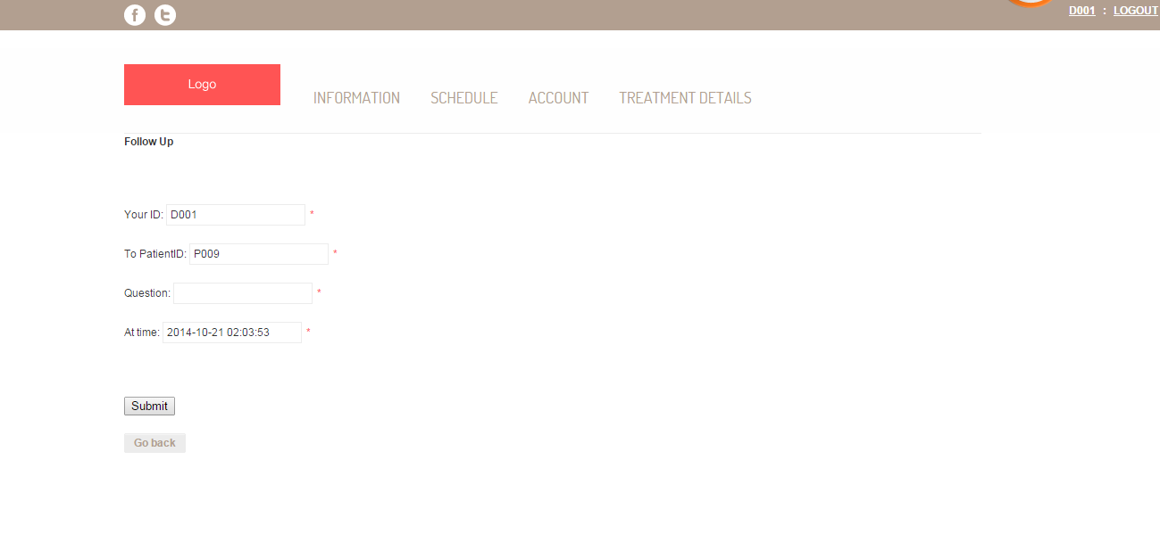
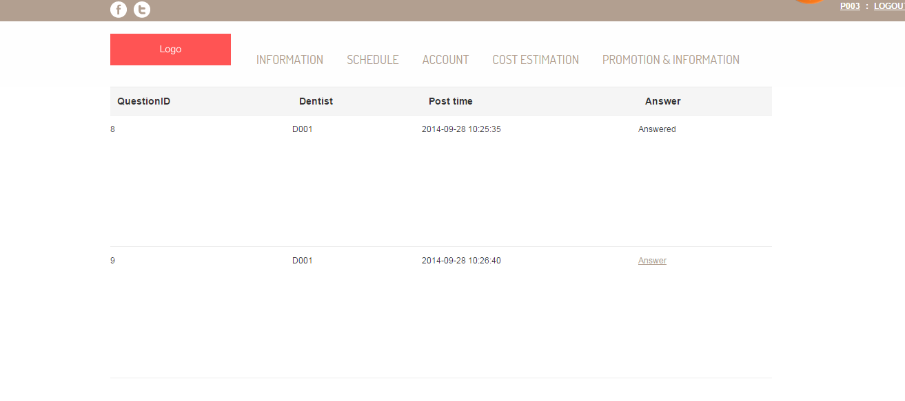
Features
13
Feature 5: Dental care consulting and following up
Mobile application
Web application

Slide 14

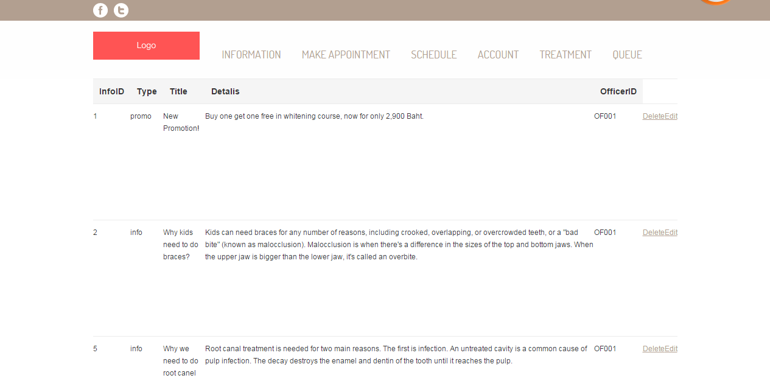

Features
14
Feature 6: A dental clinic information and promotion
Mobile application
Web application

Slide 15
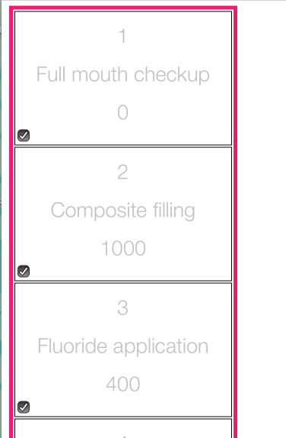
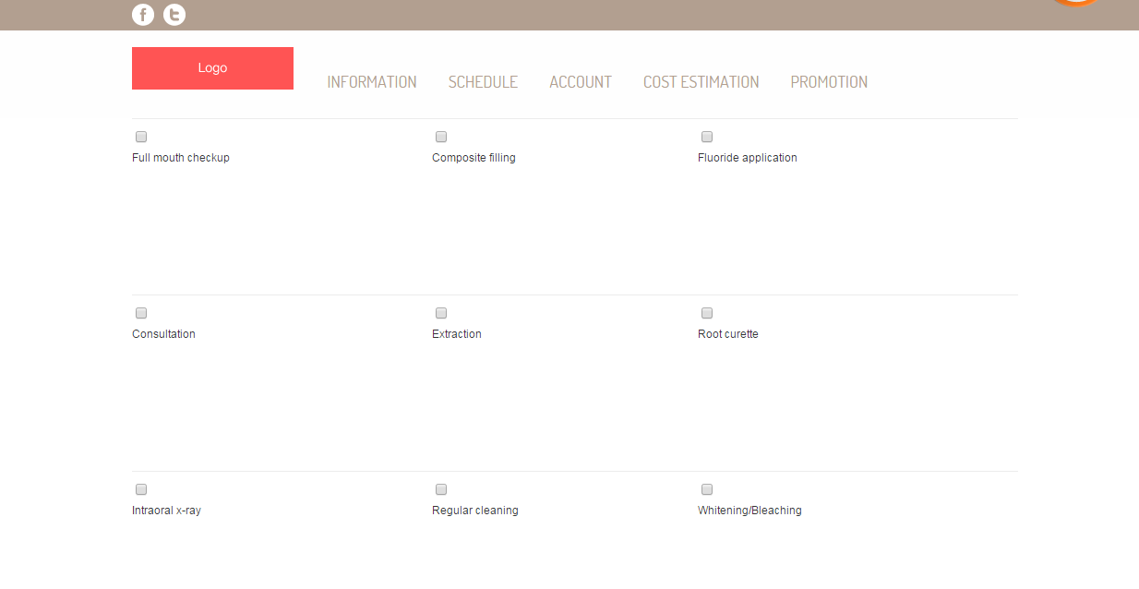
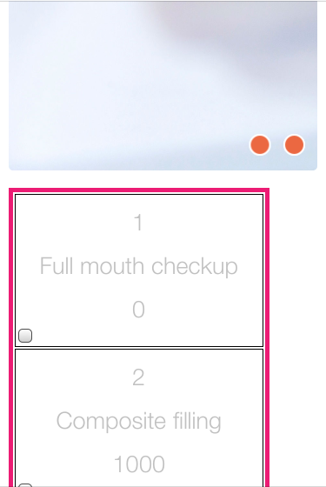
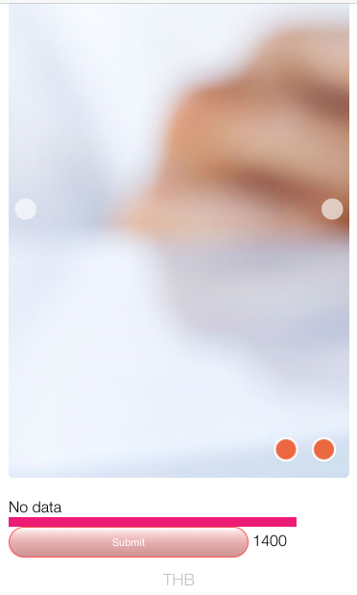
Features
15
Feature 7: Cost estimation of dental treatments
Mobile application
Web application

Slide 16
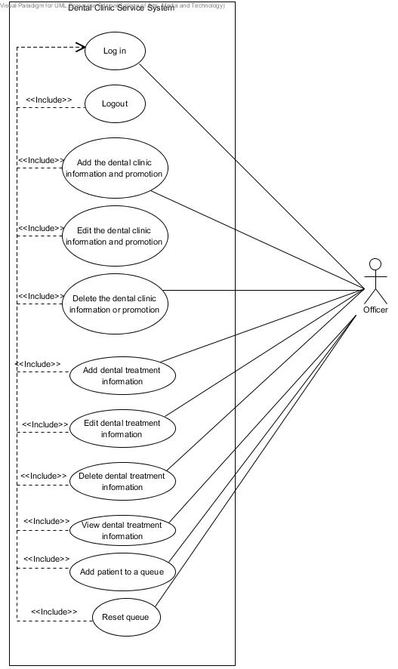
Use Case Diagram
16
Officer

Slide 17
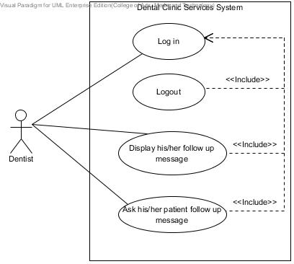
Use Case Diagram
17
Dentist

Slide 18
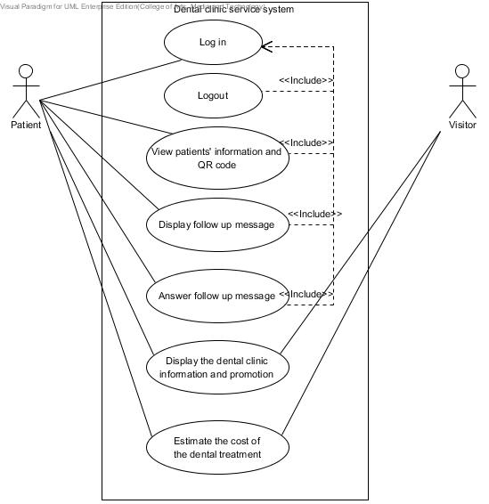
Use Case Diagram
18
Patient and Visitor

Slide 19
Software Requirement Specification
19
URS-31: Dentist can post question to follow up his/her patient (14 SRSs)
SRS-01: System shall connect with the database
SRS-59: System shall show error message “Please fill out this field” for any field that requires being not empty
SRS-63: System shall provide the dent follow up page in the website
SRS-64: System shall provide the follow up form in the dent follow up page in the website
SRS-67: System shall retrieve the patient’s message data including the answer from the database
SRS-68: System shall provide the patient’s message data as a list in the dent follow up page in the website
SRS-70: System shall retrieve the dentist’s message data including the question from the database
SRS-71: System shall provide the dentist’s message data as a list in the dent follow up page in the website
SRS-72: System shall add the dentist’s message data including question and answer into the database
SRS-73: System shall update follow up table in the database
SRS-104: System shall return true if the question is already save
SRS-105: System shall return false if the question is not saved yet
SRS-106: System shall return true if the answer is already save
SRS-107: System shall return false if the answer is not saved yet

Slide 20
Software Requirement Specification
20
URS-33: Patient can answer follow up massage that his/her dentist asked in the website (14 SRSs)
SRS-01: System shall connect with the database
SRS-59: System shall show error message “Please fill out this field” for any field that requires being not empty
SRS-67: System shall retrieve the patient’s message data including the answer from the database
SRS-69: System shall add the patient’s message data including the answer into the database
SRS-70: System shall retrieve the dentist’s message data including the question from the database
SRS-73: System shall update follow up table in the database
SRS-100: System shall provide the patient follow up page in the website
SRS-101: System shall provide the follow up form in the patient follow up page in the website
SRS-102: System shall provide the patient’s message data as a list in the patient follow up page in the website
SRS-103: System shall provide the dentist’s message data as a list in the patient follow up page in the website
SRS-104: System shall return true if the question is already save
SRS-105: System shall return false if the question is not saved yet
SRS-106: System shall return true if the answer is already save
SRS-107: System shall return false if the answer is not saved yet

Slide 21
Use Case Description
21
Use Case ID: | UC-31
Use Case Name: | Post the question for following up with his/her patient
Created By: | Worapun Wongkium | Last Updated By: | Kanokwan Maneerat
Date Created: | 15/09/2014 | Last Revision Date: | 19/10/2014
Actors: | Dentist
Description: | Dentist can post question to follow up his/her patient
Trigger: | Dentist select patientID in the list for asking
Preconditions: | Dentist is already logged into the website by using dentistID and password
Postconditions: | Dentist is already leave the question for following up his/her patient in dent follow up page
Normal Flow: | Dentist select dent follow up page System shall provide the dent follow up page in the website System shall connect with the database System shall retrieve the patient’s message data including the question and answer from the database System shall provide the patient’s message data as a list in the dent follow up page in the website Dentist select patientID to ask some question with his/her patient for following up System shall provide the follow up form in the dent follow up page in the website Dentist input the question in the form and press submit button System shall add the dentist’s message data including question and answer into the database System shall update follow up table in the database Dentist enter into the dent follow up page System shall retrieve the dentist’s message data including the question from the database System shall provide the dentist’s message data as a list in the dent follow up page in the website Dentist can view his/her status that is the question is posted or not Dentist can view his/her patient answer’s status that is patient already answer or not
Alternative Flows: | 8a. Dentist presses submit button and some field is empty. System shall show error message “Please fill out this field” for any field that requires being not empty Go back to normal flow 8 14a. Patient can view his/her status that is the answer is posted or not System shall return true if the question is already save System shall return false if the question is not saved yet 15a. Patient can view his/her dentists question’s status that is dentist is already post or not System shall return true if the answer is already save System shall return false if the answer is not saved yet
Exceptions: | System will not connect to the database and deliver information if there is no internet connection.

Slide 22
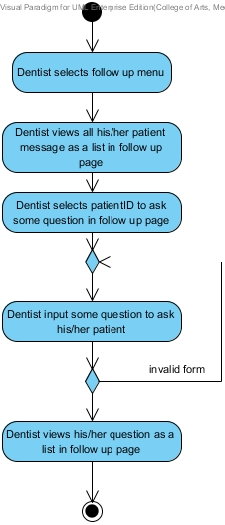
Activity Diagram
22
AD-27 :
Post the question for following up with his/her patient

Slide 23
Use Case Description
23
Use Case ID: | UC-33
Use Case Name: | Answer follow up question
Created By: | Worapun Wongkium | Created By: | Kanokwan Maneerat
Date Created: | 15/09/2014 | Date Created: | 19/10/2014
Actors: | Patient
Description: | Patient can answer follow up massage that his/her dentist asked in the website
Trigger: | Patient select the question from his/her dentist for answer
Preconditions: | Patient is already logged into the website by using patientID and password
Postconditions: | Patient is already answer the question for following up his/her dentist in patient follow up page
Normal Flow: | Patient selects patient follow up page System shall connect with the database System shall provide the patient follow up page in the website System shall retrieve the dentist’s message data including the question from the database System shall provide the dentist’s message data as a list in the patient follow up page in the website Patient select the dentist’s question to answer System shall provide the follow up form in the patient follow up page in the website Patient input the answer in the form and press submit button System shall add the patient’s message data including the answer into the database System shall update follow up table in the database Patient enter into the patient follow up page System shall retrieve the patient’s message data including the answer from the database System shall provide the patient’s message data as a list in the patient follow up page in the website Patient can view his/her status that is the answer is posted or not Patient can view his/her dentists question’s status that is dentist is already post or not
Alternative Flows: | 8a. Patient presses submit button and some field is empty. System shall show error message “Please fill out this field” for any field that requires being not empty Go back to normal flow 8 14a. Patient can view his/her status that is the answer is posted or not System shall return true if the question is already save System shall return false if the question is not saved yet 15a. Patient can view his/her dentists question’s status that is dentist is already post or not System shall return true if the answer is already save System shall return false if the answer is not saved yet
Exceptions: | System will not connect to the database and deliver information if there is no internet connection.

Slide 24
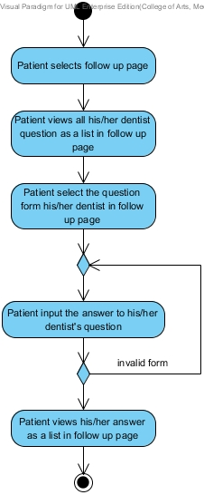
Activity Diagram
24
AD-29 :
Answer follow up question

Slide 25
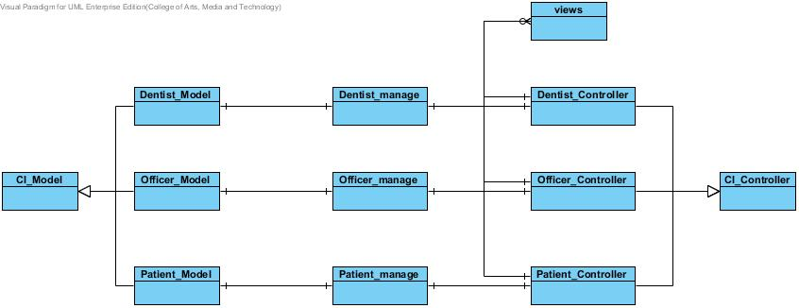
Class Diagram
25

Slide 26
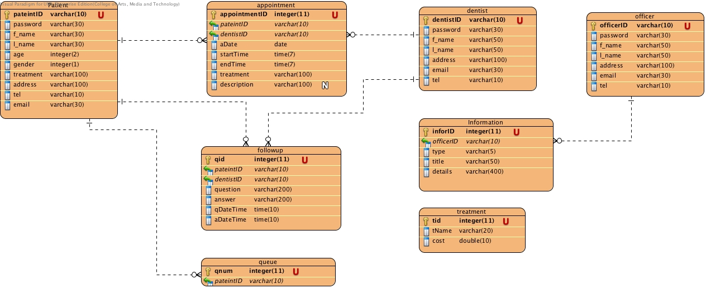
Database Diagram
26
For progress 2

Slide 27
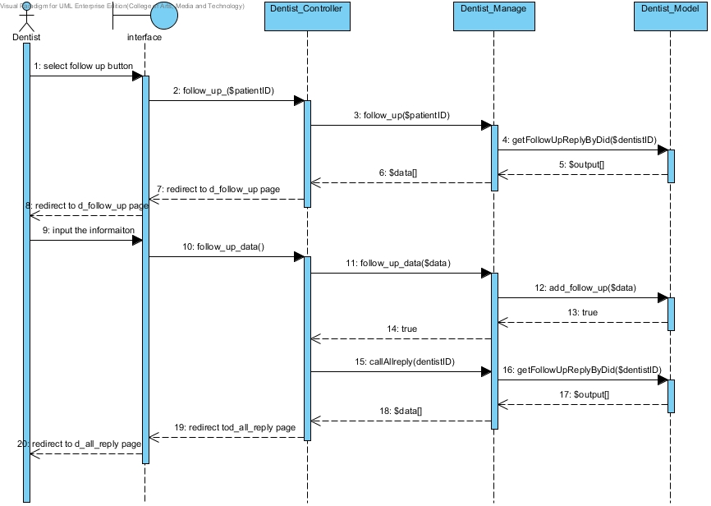
Sequence Diagram
27
SD-24: Reply follows up message
Dentist

Slide 28
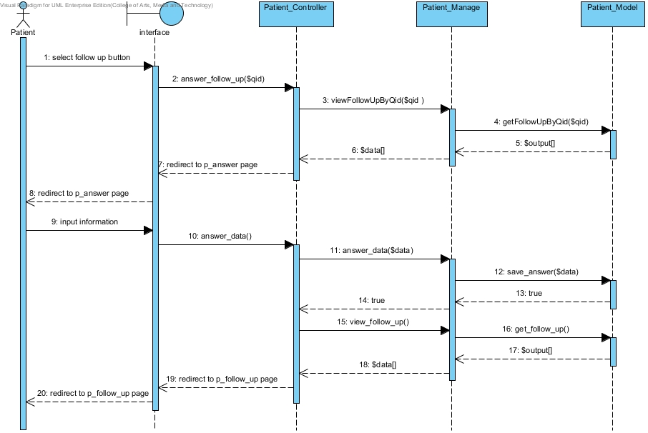
Sequence Diagram
28
SD-24: Reply follows up message
Patient

Slide 29
Testing
29
Unit test
Unit Test Case 29 (UTC-29): testp_answer_data()
Description: Test the function of answer a follow up question:
public function answer_data($data)
Test Data:
Parameter name | Parameter type | Value
$in_data | Array | [qid]=>14, [patientID]=>P001, [dentistID]=>D001, [question]=>How are your composite filling? Is that fine?, [answer]=>Nothing wrong, still fine, [qDateTime]=>2014-10-19 11:04:35, [aDateTime]=>2014-10-19 19:39.00
$expResult1 | Boolean | true
$expResult2 | Boolean | false

Slide 30
Testing
30
Unit Test Record
Unit Test Case 29 (UTC-29): testp_answer_data()
ID | Description | Expected Result | Actual Result | Pass/Fail
1 | Test answer a follow up question at not answered question | true | true | Pass
2 | Test answer a follow up question at answered question | false | false | Pass

Slide 31
Testing
31
Unit test
Unit Test Case 34 (UTC-34): testd_follow_up_data()
Description: To test the function of adding follow up question to specific patientID: public function follow_up_data($data)
Test Data:
Parameter name | Parameter type | Value
$in_data | Array | [qid]=>14, [patientID]=>P001, [dentistID]=>D001, [question]=>How are your composite filling? Is that fine?, [answer]=>null, [qDateTime]=>2014-10-19 11:04:35, [aDateTime]=>null
$expResult1 | Boolean | true

Slide 32
Testing
32
Unit Test Record
Unit Test Case 34 (UTC-34): testd_follow_up_data()
ID | Description | Expected Result | Actual Result | Pass/Fail
1 | Test to add a follow up question and save to the database | true | true | Pass

Slide 33
Future Work
33
For Final Progress
Feature 4: Patient identification using QR code

Slide 34



34
Demo

Slide 35
35
Q & A

Slide 36
36
Thank you
For your attention

